Slide 1
Class 11:
Mining Pools and Attacks
Cryptocurrency Café
UVa cs4501 Spring 2015
David Evans

Slide 2
Plan for Today
PointCoin Update
Mining Pools
Attacks and Vulnerabilities

Slide 3
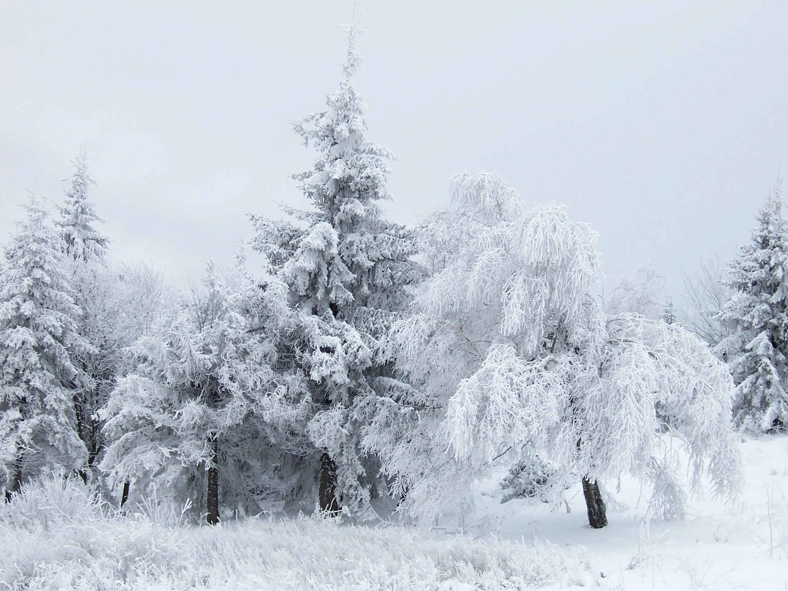
Snow Day!

Slide 4
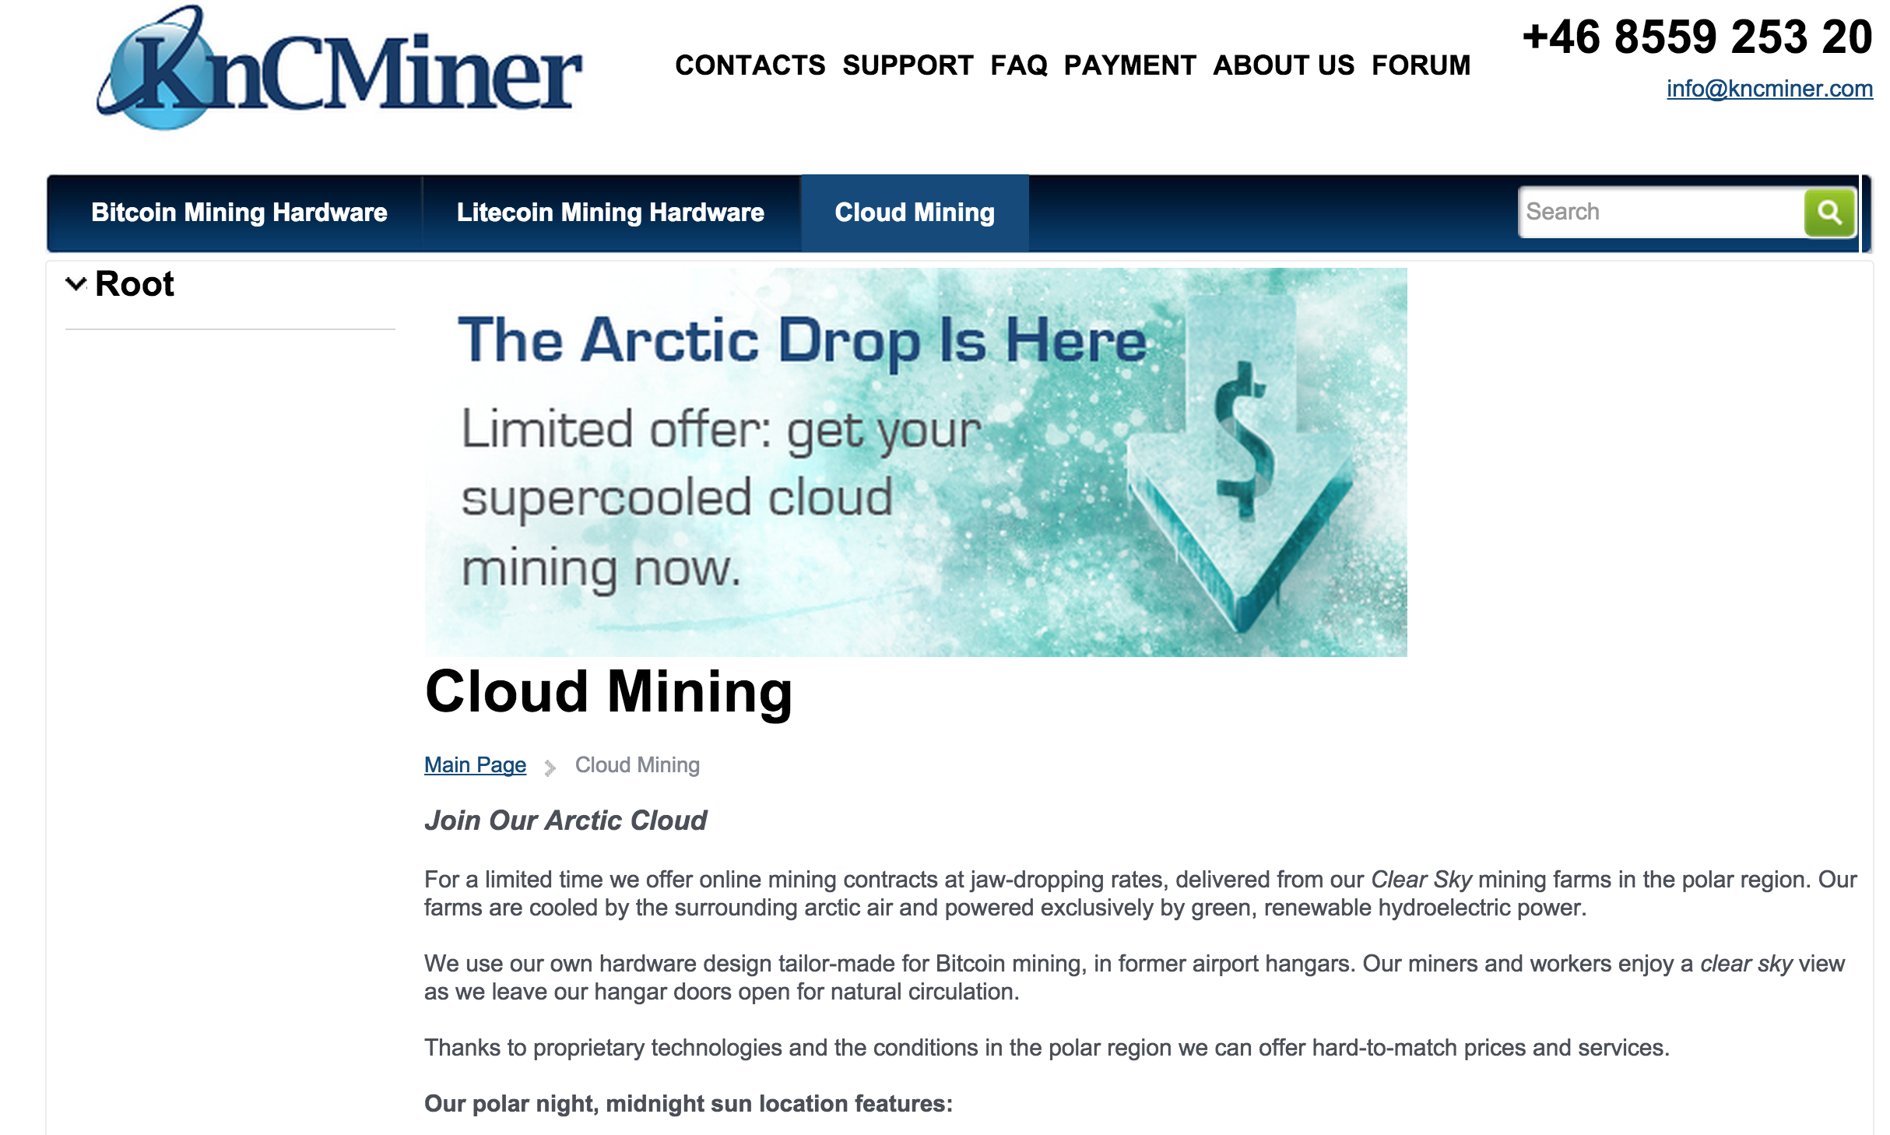

Slide 5

Is this gambling or a “good/bad” investment?

Slide 6
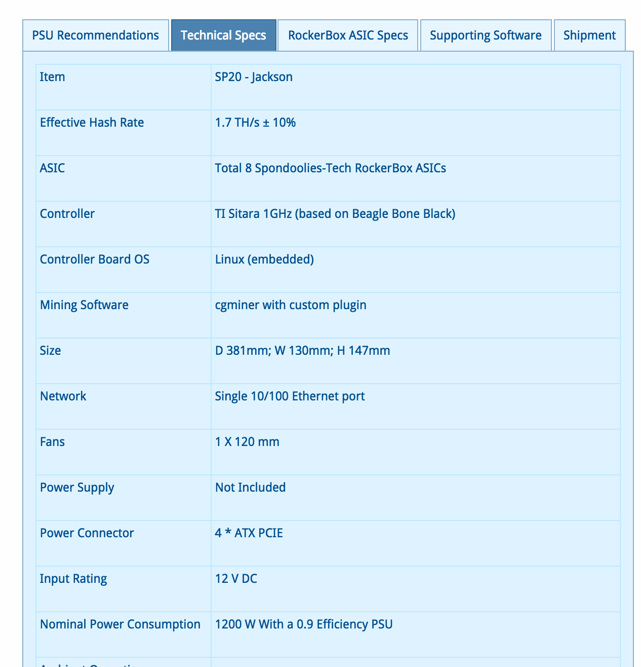

Slide 7
Expected Revenues (?)
Model
Cost: US$ 479
1.7 TH/s
BTC: US$ 240
Difficulty: (today)
>>> expected_hashes # at current difficulty
1.9093455768686638e+20
>>> expected_hashes / (1.7 * 10**12)
112314445.6981567 # expected seconds to find block
>>> _ / (60 * 60 * 24)
1299.935714099036 # days to find block
>>> block_value = 240 * 25
>>> earnings_per_year = block_value * (365.25 / 1300)
>>> earnings_per_year
1685.769230769231

Slide 8
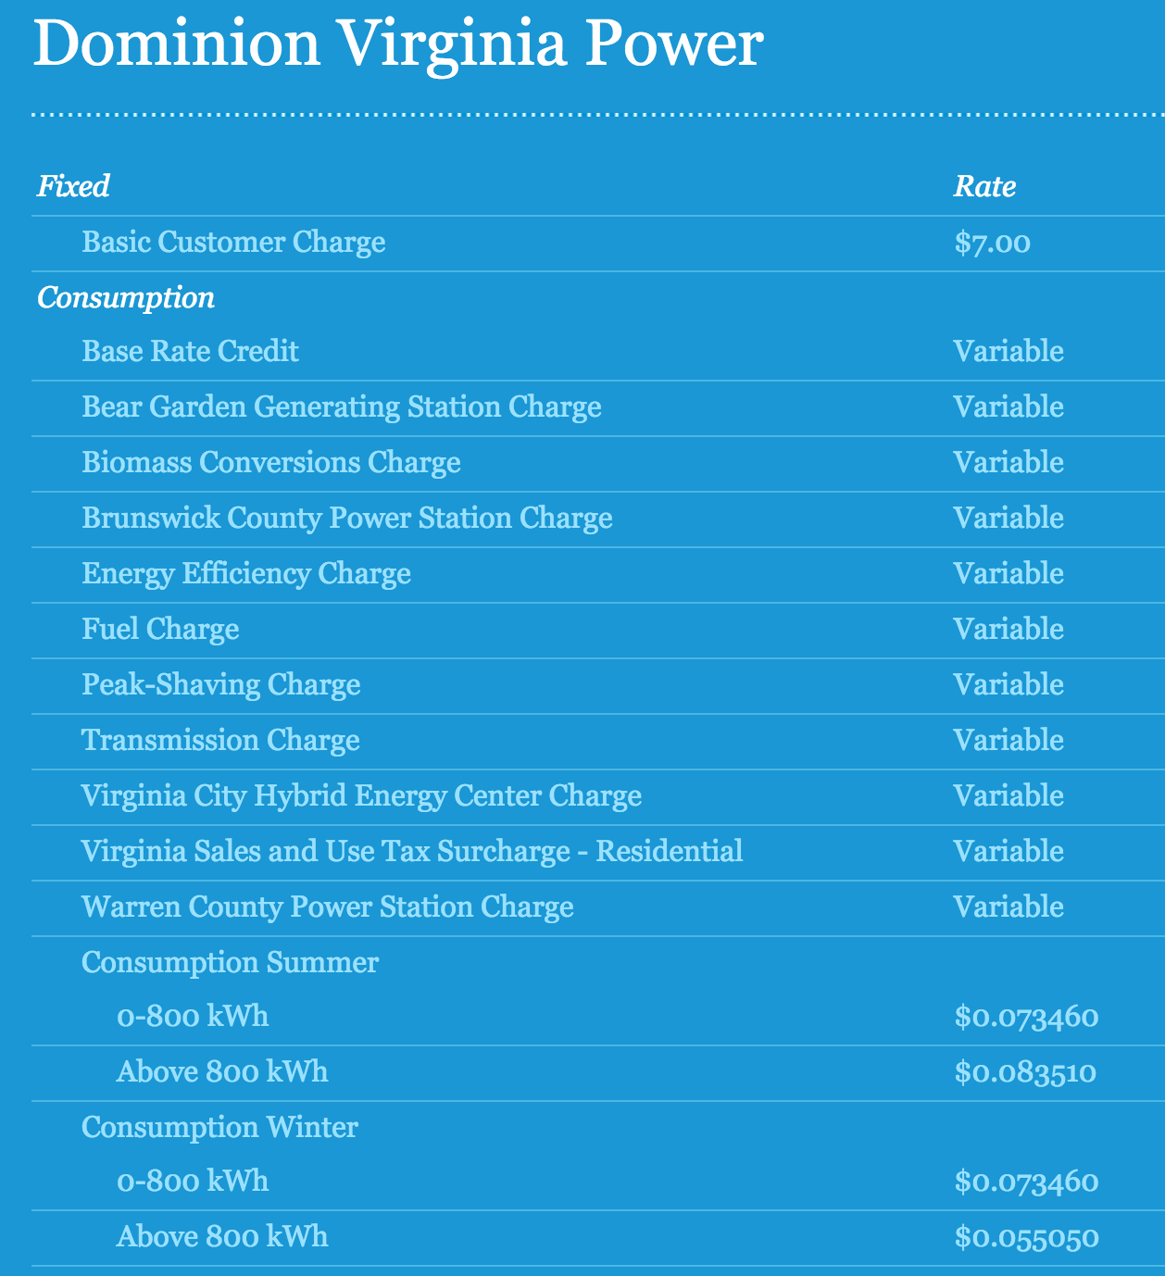
Operating Cost

Slide 9
Operating Profit
>>> kWh = 0.07
>>> hours_per_year = 24 * 365.25
>>> electricity_cost = (1.2 * kWh) * hours_per_year
>>> electricity_cost
736.344 # US $ per year
>>> profit_per_year = earnings_per_year - electricity_cost
949.4252307692309

Slide 10
Easy Money?

Slide 11
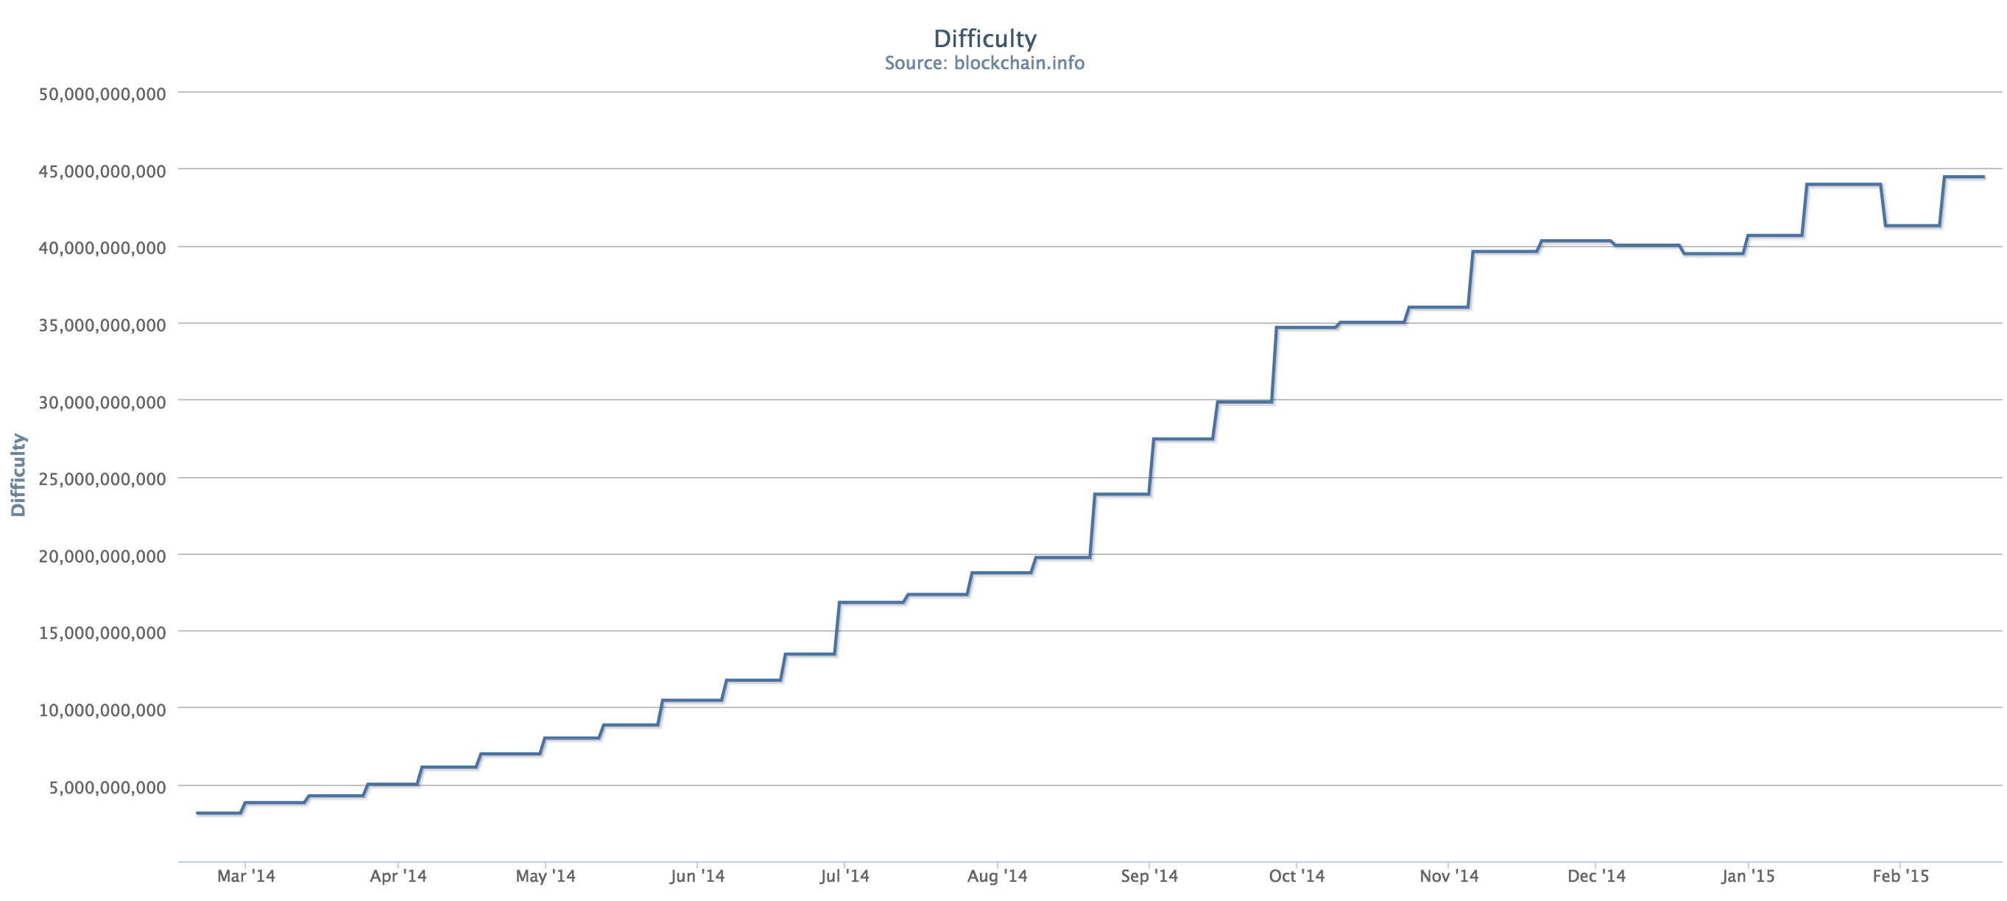
March 2014

Slide 12
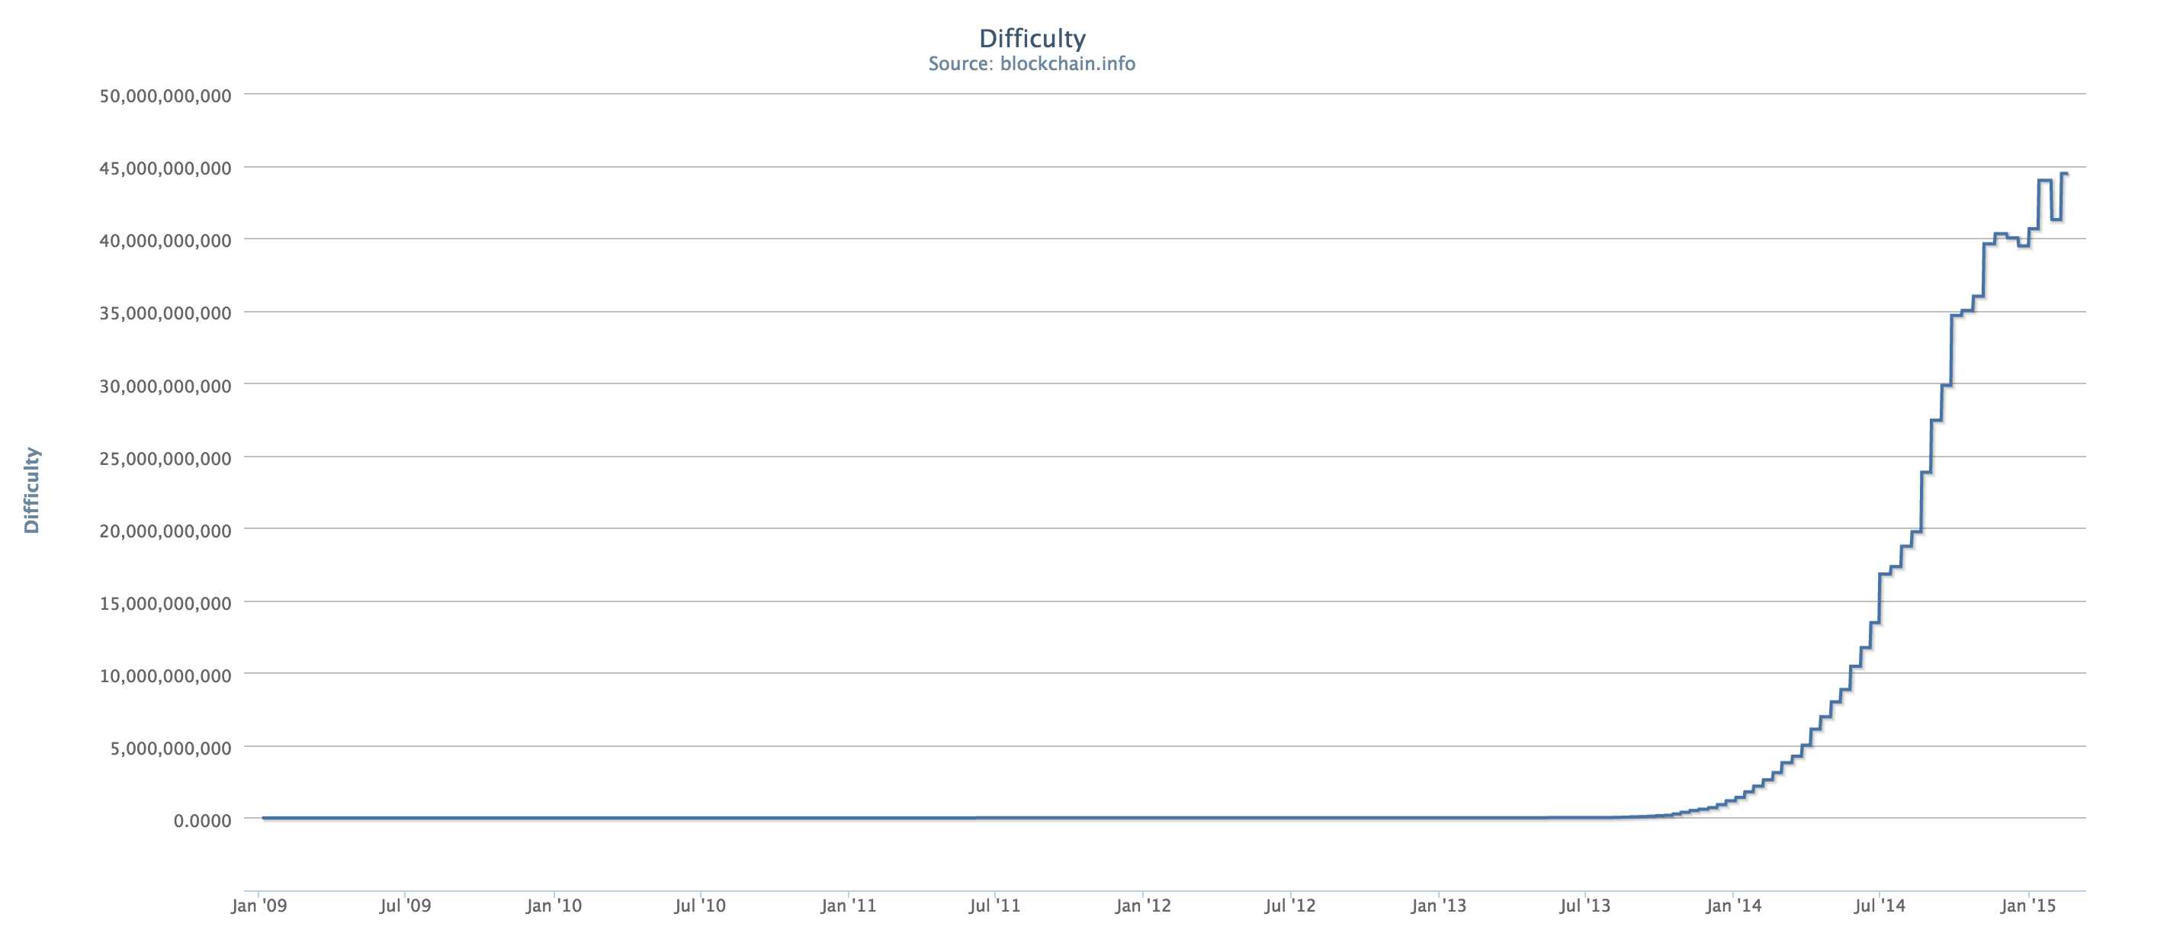

Slide 13
# this is a very low assumption - over past year, average rate was 0.35
rate_of_difficulty = 0.05
def guess_difficulty(month):
return difficulty * ((1 + rate_of_difficulty) ** month)
def expected_revenue(month):
success_probability = find_target(guess_difficulty(month)) / 2**256
return block_value * hashes_in_month * success_probability
def cumulative_income(months):
income = 0.0
month = 0
while month < months:
income += expected_income(month)
month += 1
return income

Slide 14
>> cumulative_income(1)
79.12571644571238
>>> cumulative_income(12)
571.0928818228372
>>> cumulative_income(24)
562.7786595271843
>>> cumulative_income(17)
619.9072133191279

Slide 15
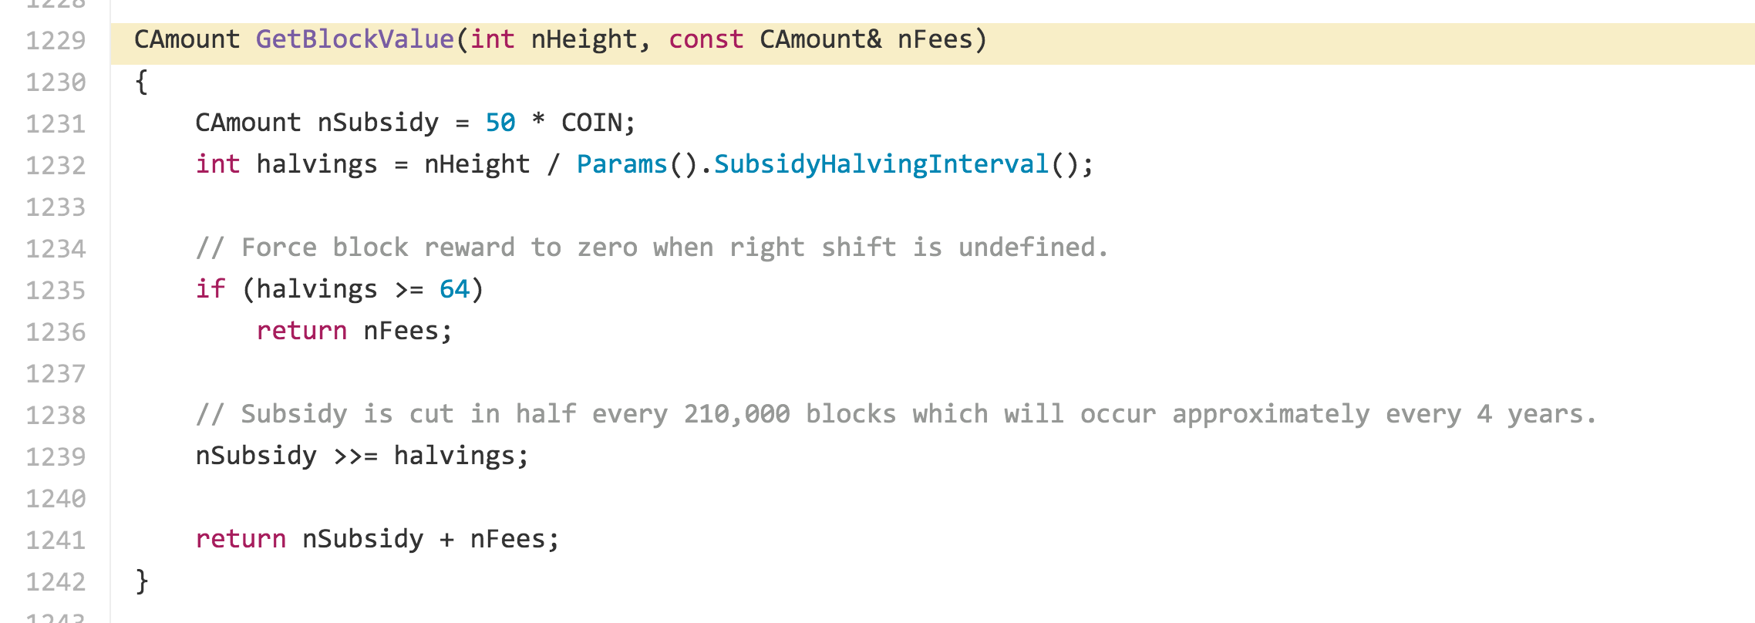
Block Value

Slide 16
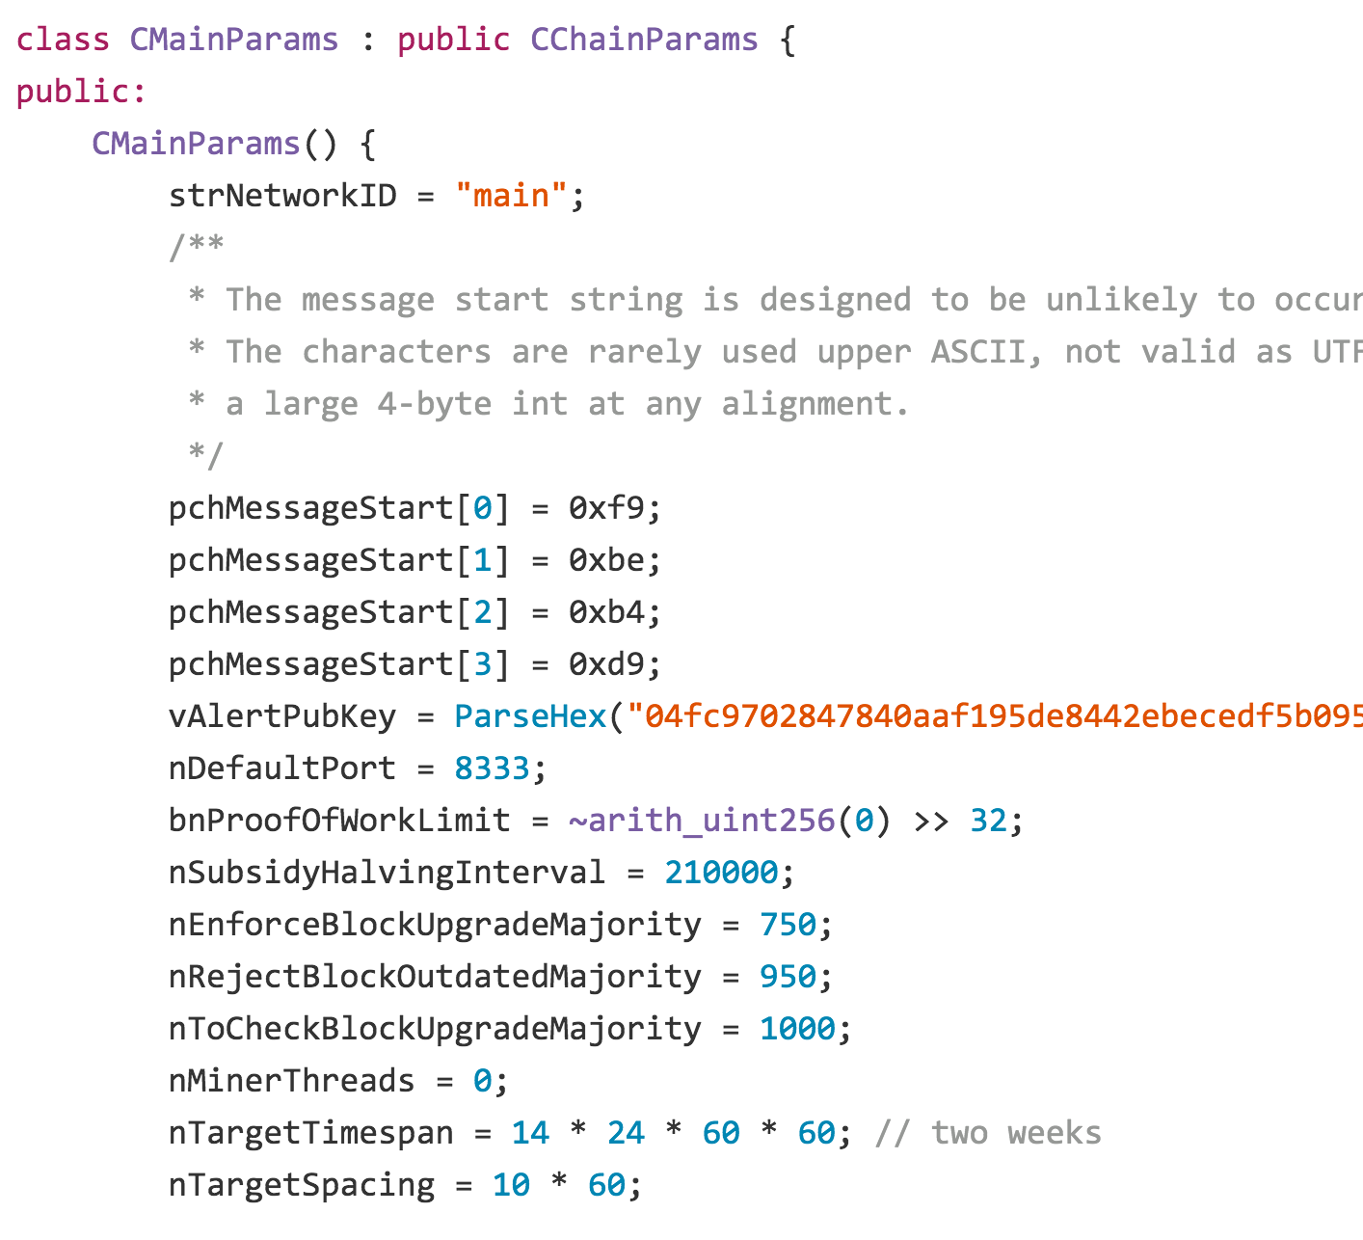

Slide 17
What happened around block 210000?
https://blockchain.info/block/00000000000000f3819164645360294b5dee7f2e846001ac9f41a70b7a9a3de1

Slide 18
Date | Difficulty | Block # | Days (delta) | Increase % Per Difficulty Adj | Daily increase % | Tl. Network Strength (Mhash/s) | Difficulty Increase
2012-11-12 | 3,368,767 | 207648 | 13.74 | 1.95% | 0.14% | 24,114,574 | 64,411
2012-11-26 | 3,438,909 | 209664 | 13.72 | 2.08% | 0.15% | 24,616,669 | 70,142
2012-12-10 | 3,370,182 | 211680 | 14.29 | -2.00% | -0.14% | 24,124,701 | -68,727
2012-12-26 | 2,979,637 | 213696 | 15.83 | -11.59% | -0.77% | 21,329,070 | -390,545
2013-01-08 | 3,249,550 | 215712 | 12.86 | 9.06% | 0.68% | 23,261,182 | 269,913
2013-01-23 | 2,968,775 | 217728 | 15.33 | -8.64% | -0.59% | 21,251,322 | -280,774
2013-02-05 | 3,275,465 | 219744 | 12.69 | 10.33% | 0.78% | 23,446,689 | 306,689

Slide 19
Expected Outcome
Given the expected useful lifetime of 17 months for this miner, what is the most likely result?

Slide 20
Expected Outcome
def expected_blocks(month):
success_probability = find_target(guess_difficulty(month)) / 2**256
return hashes_in_month * success_probability
def cumulative_expected_blocks(months):
blocks = 0
for month in range(months):
blocks += expected_blocks(month)
return blocks
Given the expected useful lifetime of 17 months for this miner, what is the most likely result?
cumulative_expected_blocks(17)
0.27717686888652143

Slide 21
Probability Refresher
What is the probability that tossing a fair coin k times produces 0 tails?

Slide 22
Probability of Finding No Blocks
With target T, what is the probability no block is found with K hashes?

Slide 23
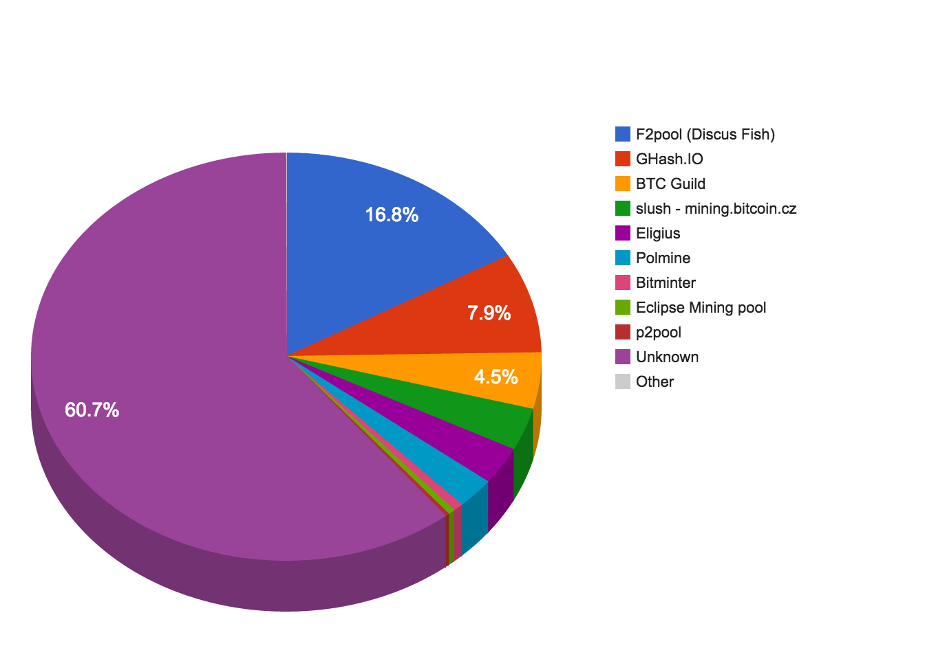

Slide 24
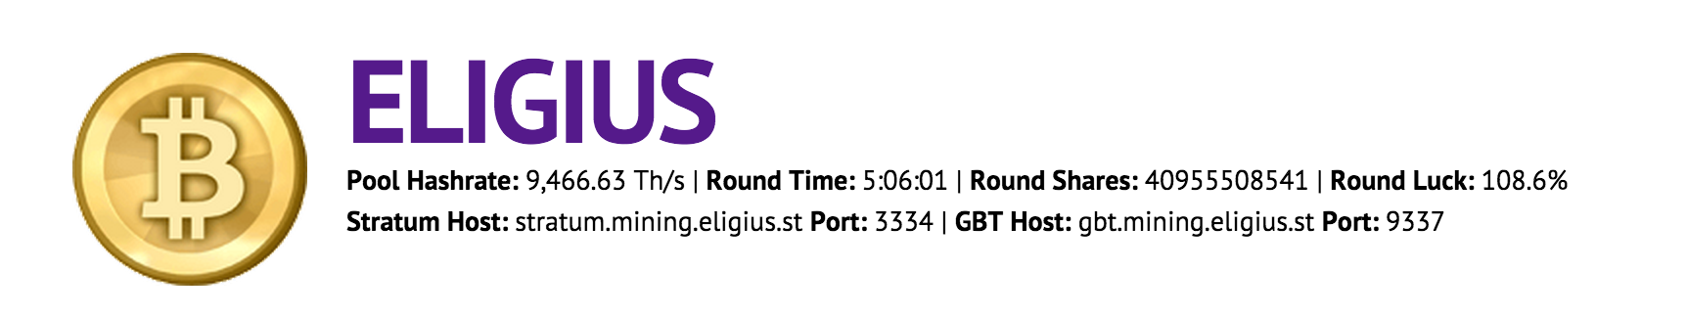
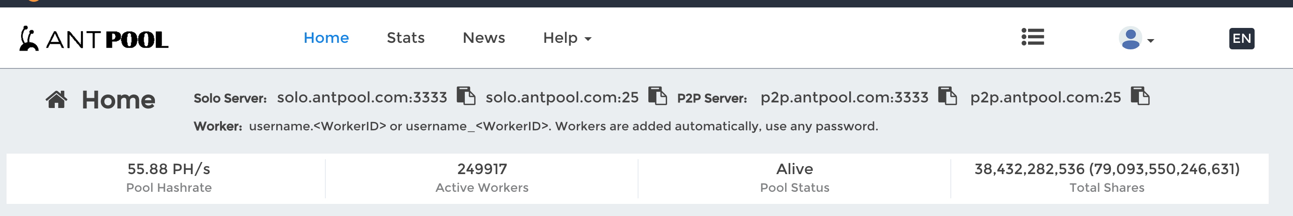
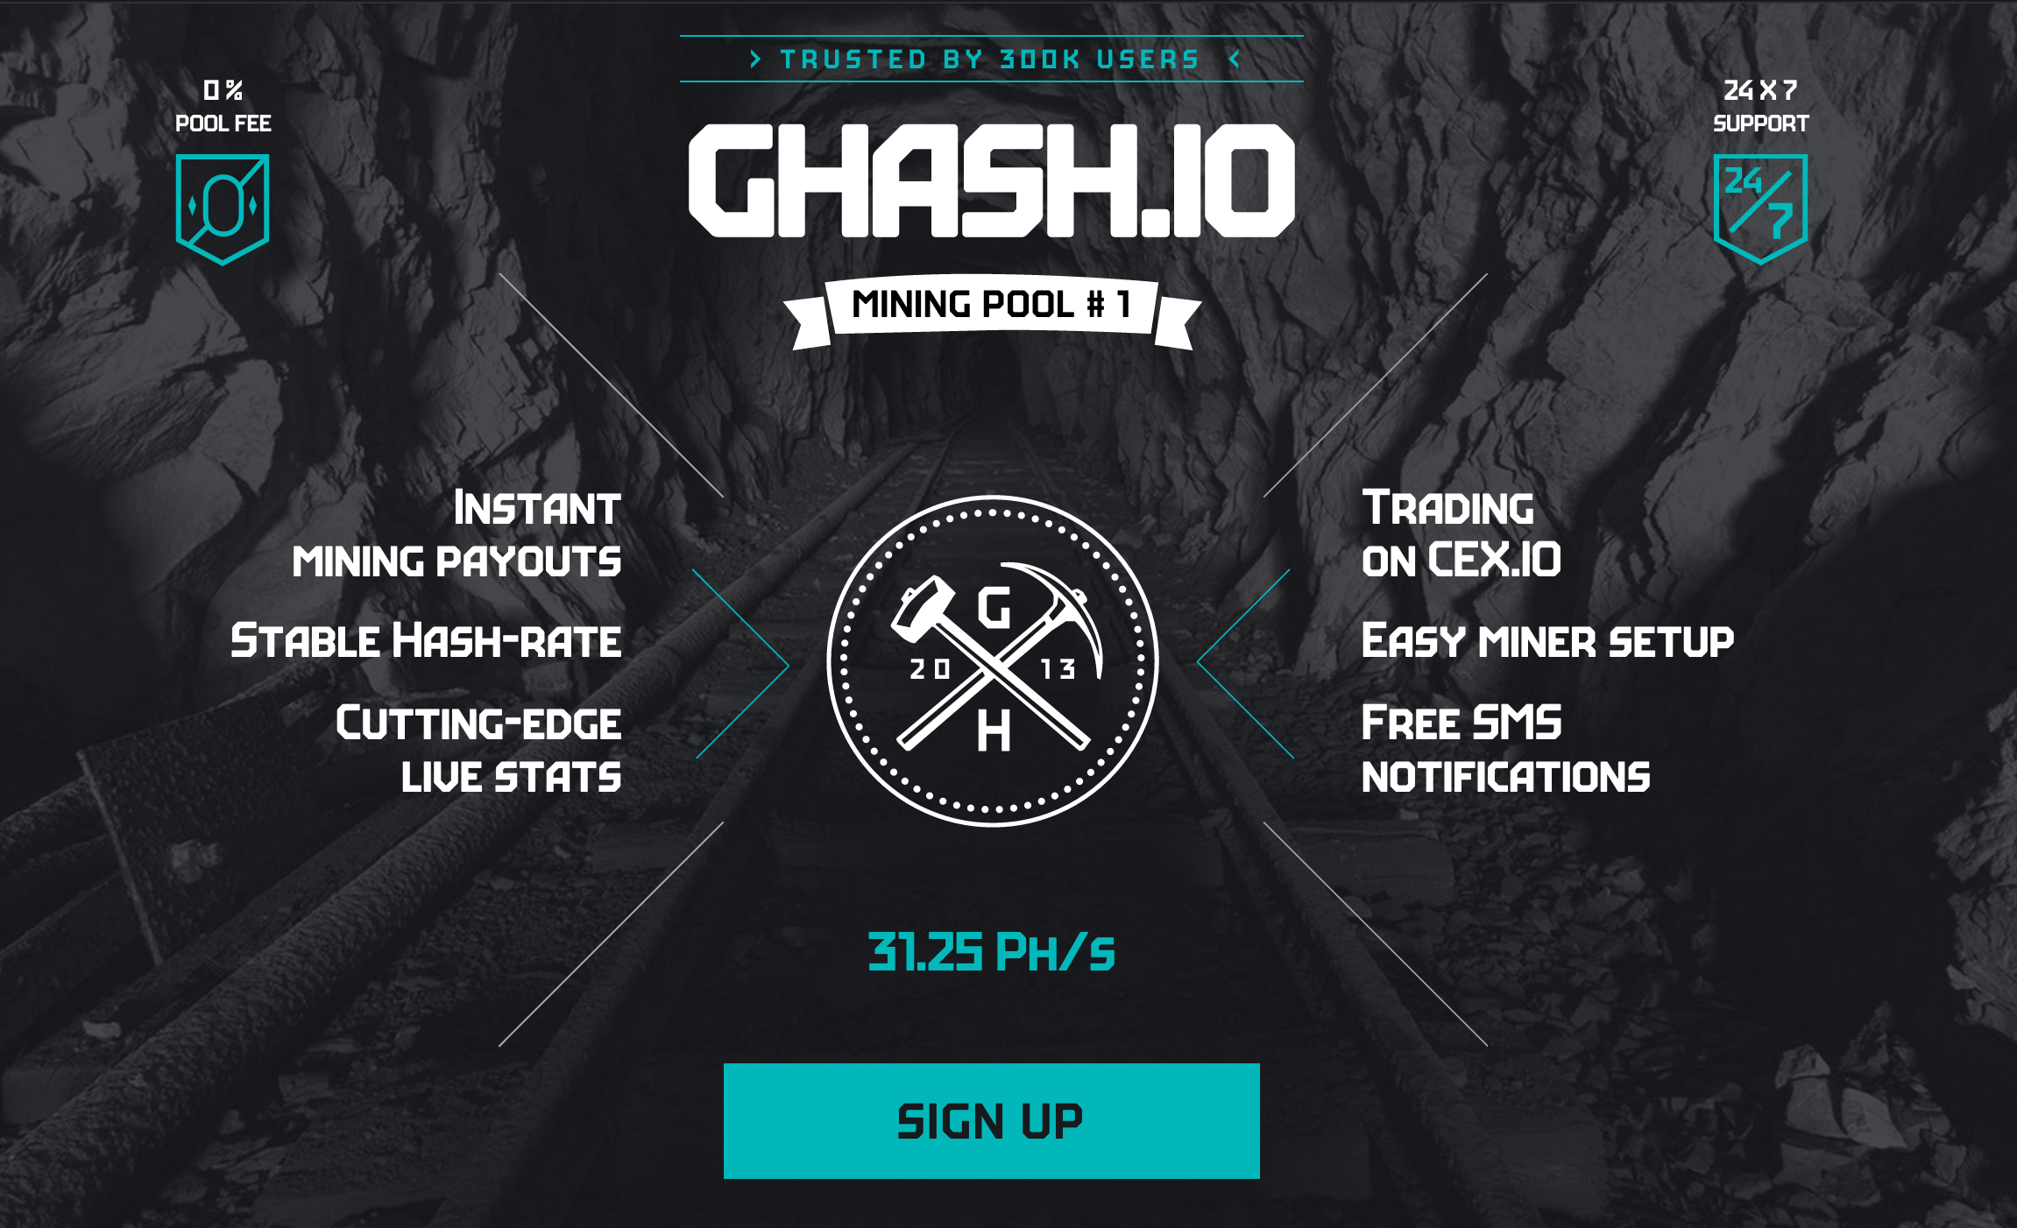
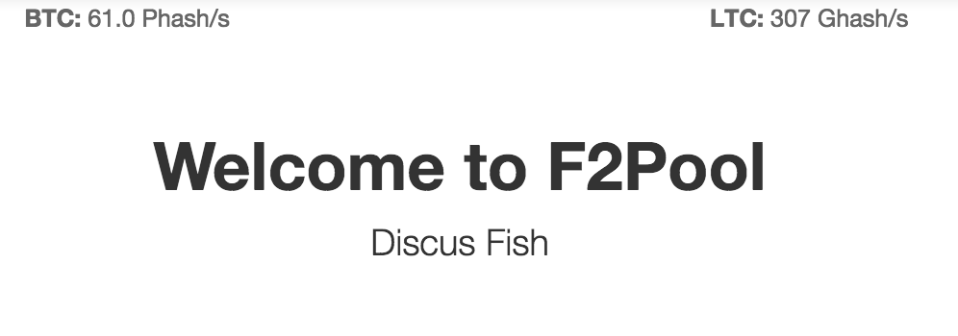
Mining Pools

Slide 25
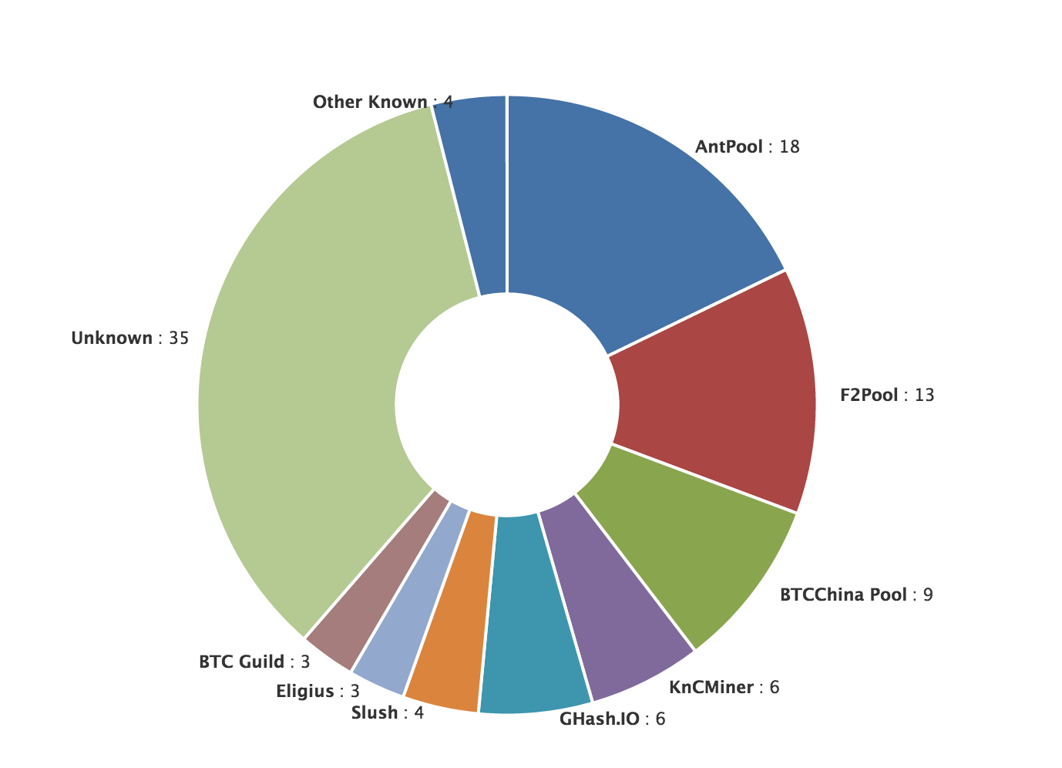
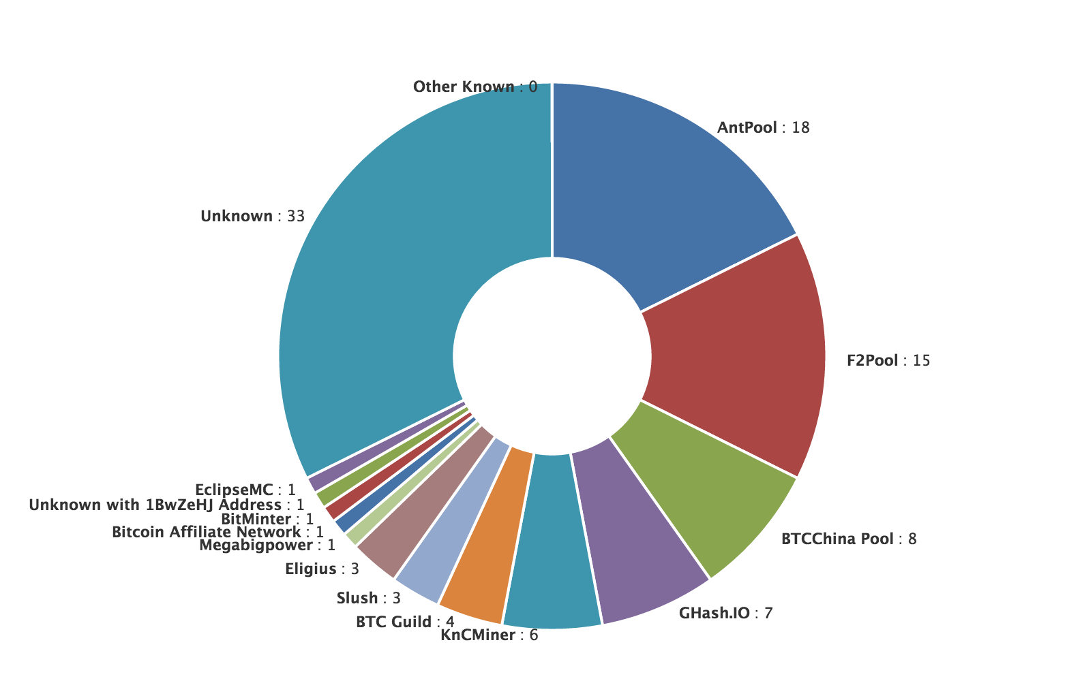
Mining Power
https://blockchain.info/pools?timespan=24hrs
Last 4 Days
Last 24 Hours

Slide 26
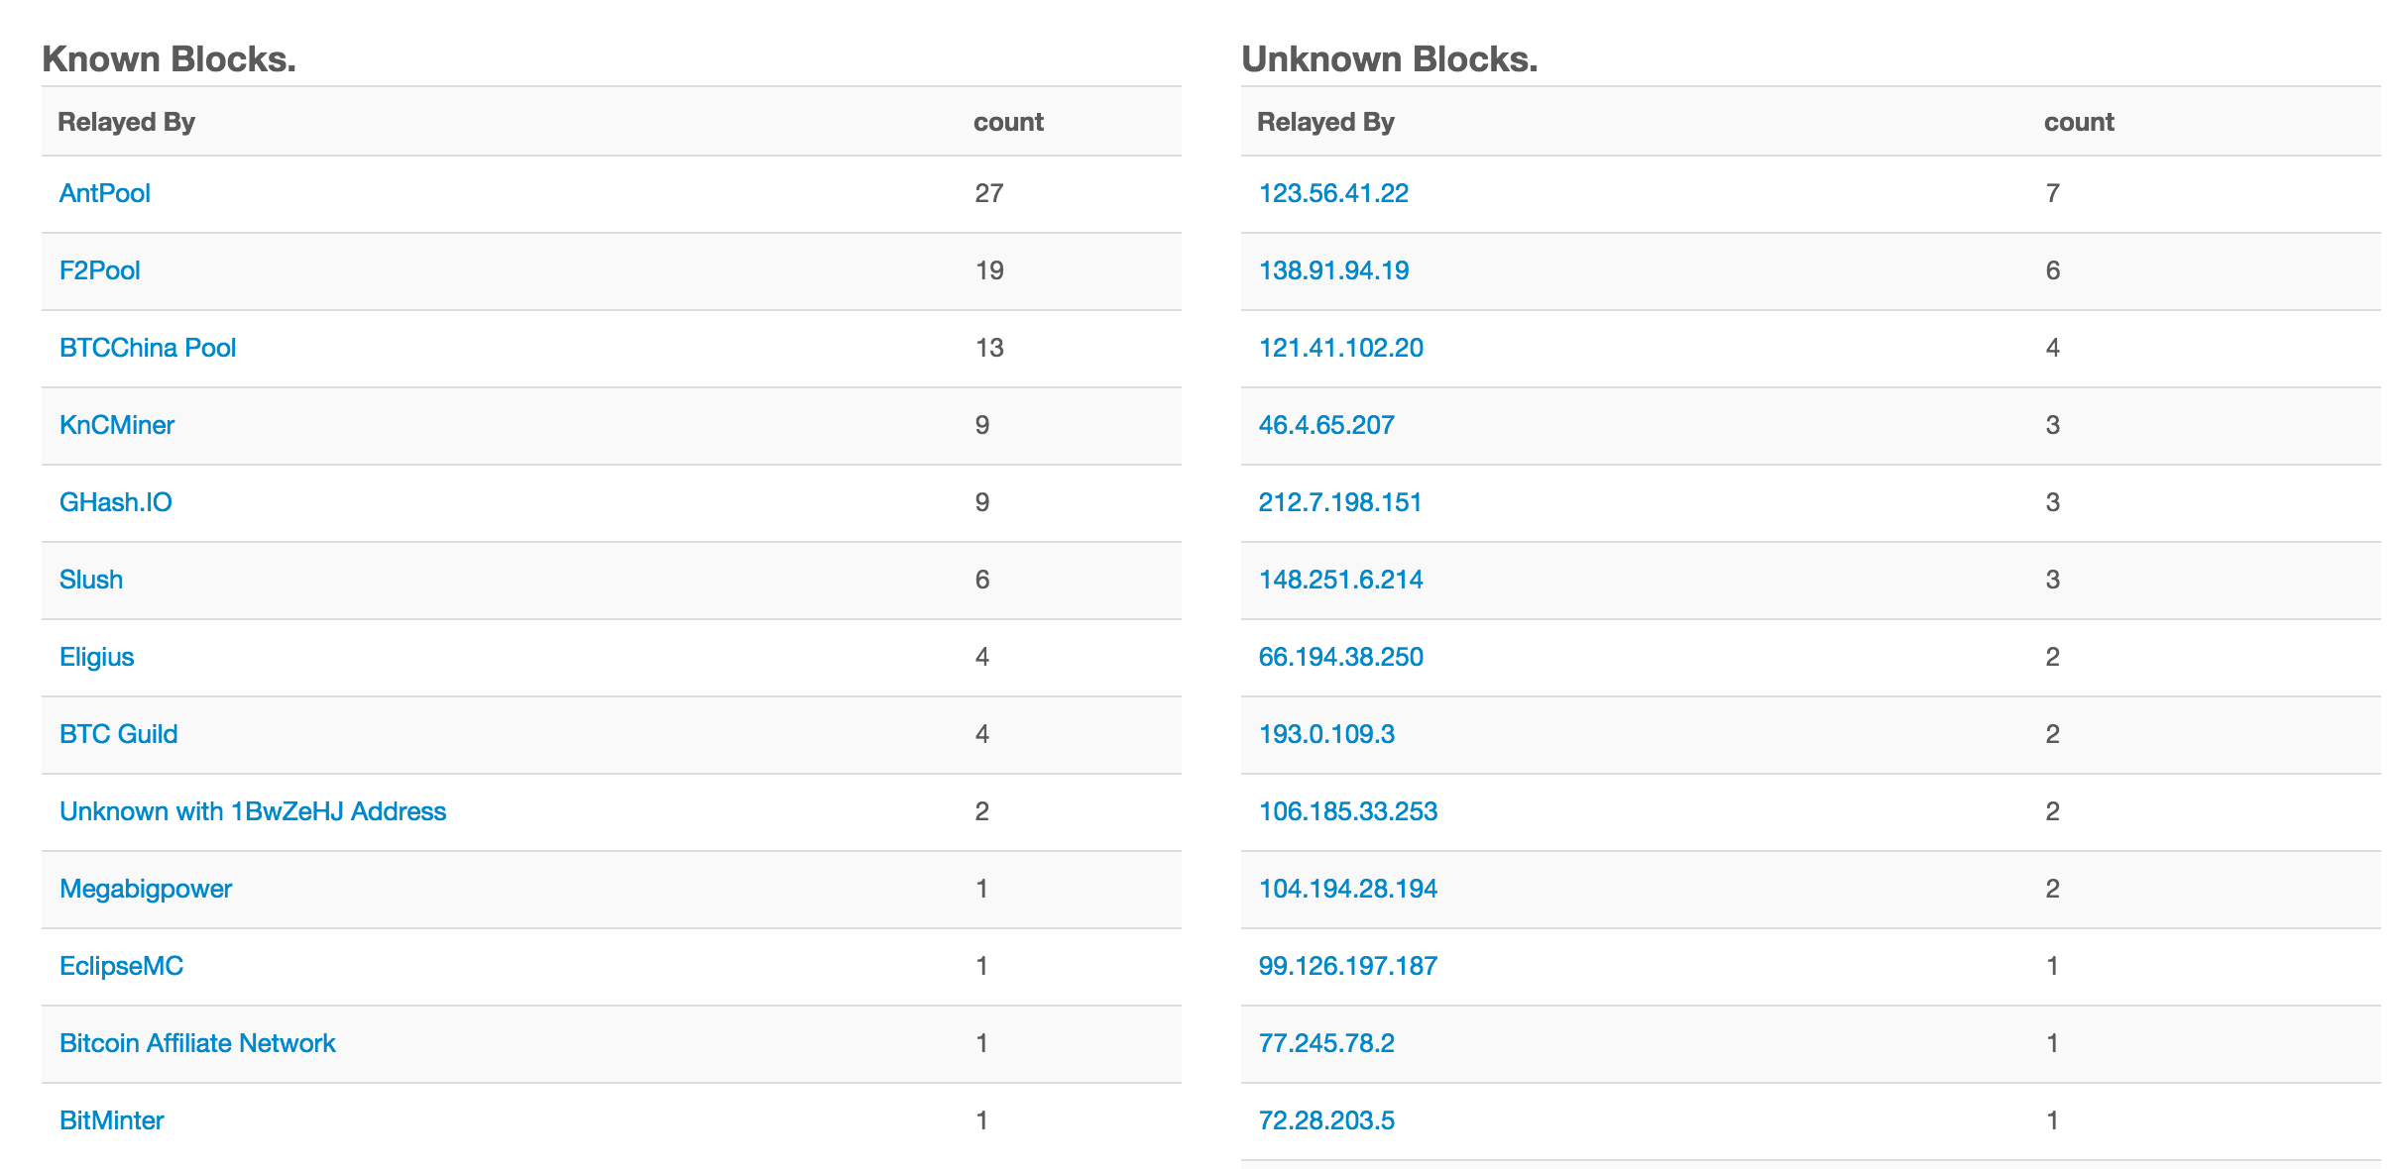
Last 24 hours

Slide 27
Mining Pools

Slide 29
Sharing the Mining Rewards

Slide 30
https://www.antpool.com/poolStats.htm

Slide 31
Mining Pool Dangers

Slide 32
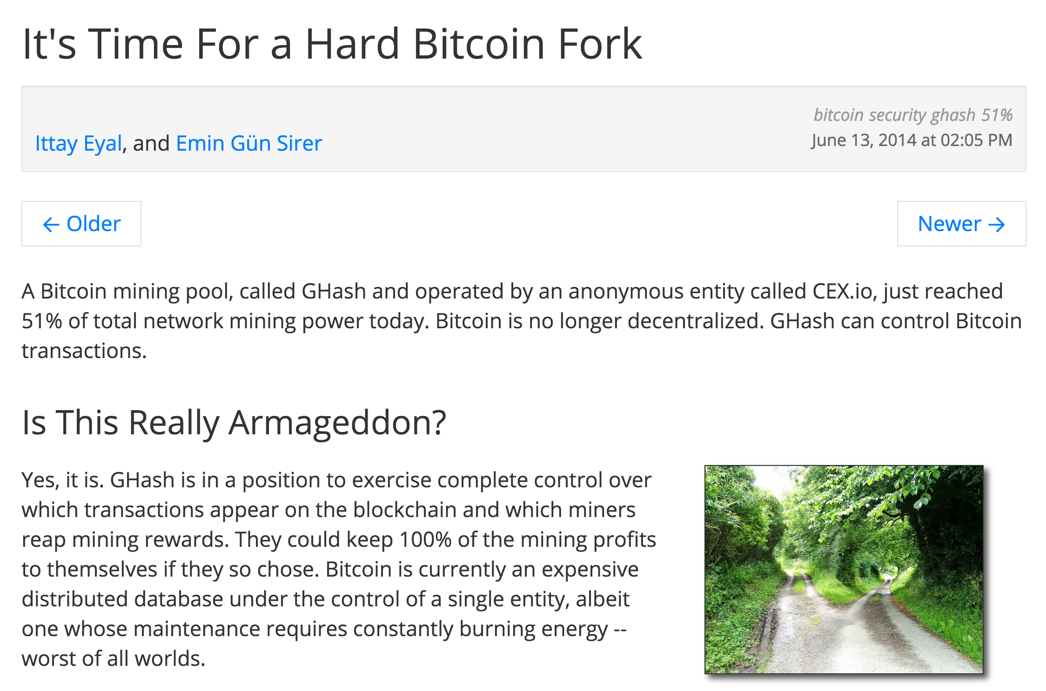

Slide 33
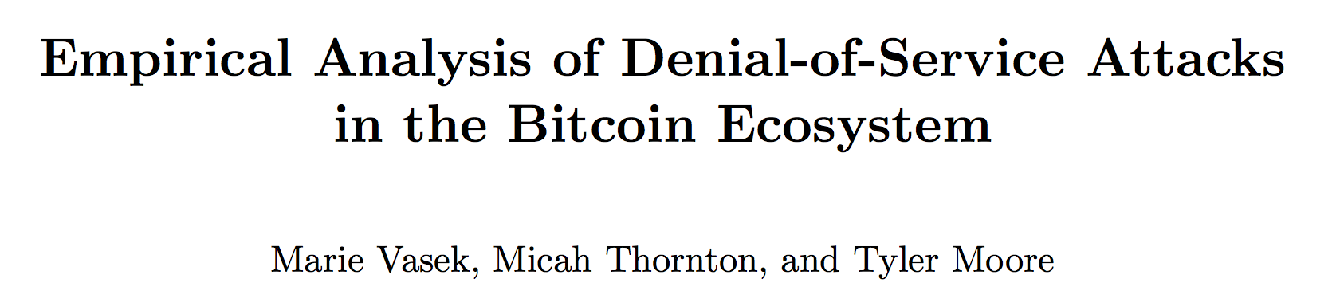
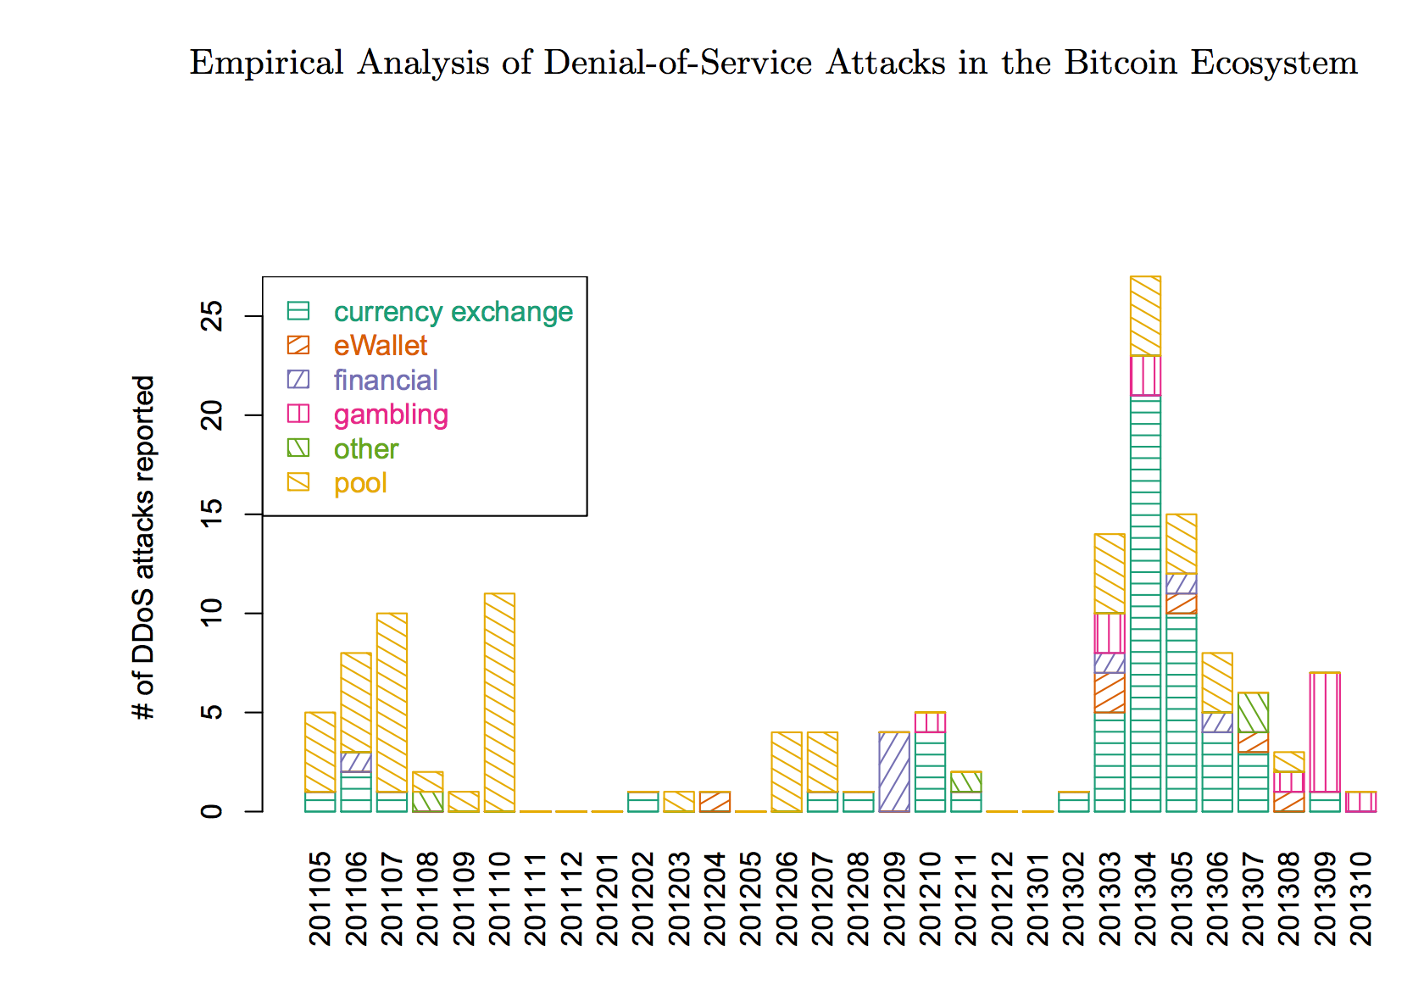
Mining Pool Attacks
DDOS-ing
Block Withholding
Lots of interesting questions about this and ongoing research…we’ll talk more in future classes. Many possible project ideas about mining pool dangers and attacks on mining pools.

Slide 34
Charge
“GHash.IO does not have any intentions to execute a 51% attack… it could risk our investments in physical hardware and we see no benefit from having 51% stake in mining.”
Don’t attack PointCoin yet!
Project 2 Part 1: Due Sunday
Quiz next Wednesday
If you don’t yet understand fundamentally how bitcoin works, definitely come to my office hours before then (Thursday 4-5pm, Monday 3:15-5pm)

